Slide 1

Module 9
Strings, Text IO, and Audio

Slide 2
9.7 Text Input
To get text input, we use another user interface component called an Input Field.
The Input Field isn't a stand-alone component, though; we need to add it to a Text component.
By the way, Input Field is called an “Interaction Component” in Unity because it's a component the player can interact with.
Create a new Unity Project, add a Text component to the scene, and rename the Text component GamertagText. Select the Text component in the Hierarchy window and change the Pos X and Pos Y values in the Rect Transform component to 0. In the Text (Script) component, change the Color to white.

Slide 3
9.7 Text Input
At this point, the text is displayed when we run the game (just like the score was in the previous section), but the player can't actually interact with the text to change it.
Click the Add Component button in the Inspector and select UI > Input Field. Now drag the GamertagText game object from the Hierarchy window onto the Text Component value of the new Input Field (Script) component.
Note: You may get a warning that says “Using Rich Text with input is unsupported”. If you do, uncheck the Rich Text checkbox under the Character heading in the Text component.
Make the text change color when the player hovers the mouse over it so they understand they can do something. To do this, change the Highlighted Color of the Input Field to be different from the Normal Color. If you run the game now, you'll see the text color change appropriately.

Slide 4

9.7 Text Input
How do we actually get the text they entered?
Add a new Scripts folder in the Project window and add a new PrintGamertag C# Script to that folder. Open up the new script in Visual Studio and change it to the following:
Add a using directive for the UnityEngine.UI namespace because the Text and InputField classes are in that namespace.

Slide 5
9.7 Text Input
How do we actually get the text they entered?
Add a new Scripts folder in the Project window and add a new PrintGamertag C# Script to that folder. Open up the new script in Visual Studio and change it to the following:
Add a using directive for the UnityEngine.UI namespace because the Text and InputField classes are in that namespace.

Slide 6
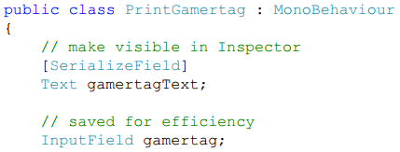
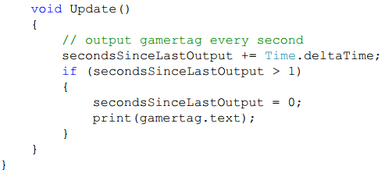
9.7 Text Input

Slide 7
9.7 Text Input
Attach the script to the Main Camera in the scene and populate the Gamertag Text field by dragging the GamertagText component from the Hierarchy window onto the field. If you run the game, you'll see the current value of the Input Field displayed in the Console window approximately every second, and you can see that value change as the player edits the contents of that Input Field.
There are many ways to make player text input more visually appealing and to process that input more efficiently (using Chapter 17 concepts in the textbook), but this example should give you a good understanding of how we can get text input from the player.

Slide 8
9.8 Putting It All Together: The Circle Problem in Unity Revisited
The problem description (solve the same problem we solved in Module 3):
Display circles with integer radii from 1 to 5 in the game window, with each circle displaying its radius and area.
Understand the Problem
As before, the problem description says to display the circles “in the game window”, but it doesn't say where, so we'll place those circles as we see fit. Also, the problem description doesn't say where we should have each circle display its radius and area, so we'll just have each circle display that information centered itself.
Design a Solution
Because each circle will be responsible for displaying itself and its information once it's been placed in the scene, it makes sense to modify the Circle script and implement the required functionality in the Start method in that script.

Slide 9
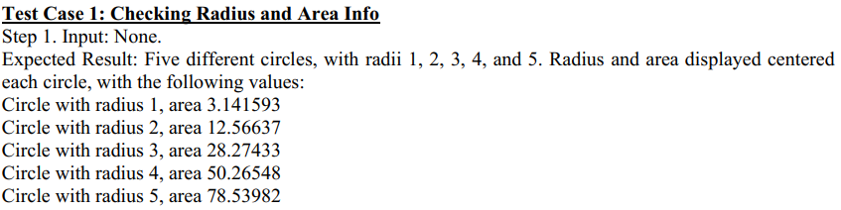
9.8 Putting It All Together: The Circle Problem in Unity Revisited
Write Test Cases

Slide 10
9.8 Putting It All Together: The Circle Problem in Unity Revisited
Write the Code
right clicking in the Hierarchy window and selecting Create Empty.
Next, we dragged the circle from the sprites folder onto our new game object, which made the sprite a child of that game object.
Next, we right clicked our game object, selected UI > Text, and named the new Text component RadiusText. We then repeated those steps to add the AreaText component.
Finally, we dragged our game object into the prefabs folder in the Project window and renamed the prefab Circle.

Slide 11


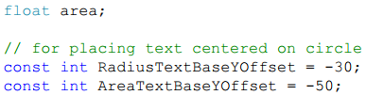
9.8 Putting It All Together: The Circle Problem in Unity Revisited
Write the Code
Add a using directive for the UnityEngine.UI namespace because the Text class is in that namespace, and use Text objects to display the radius and area information for each circle.

Slide 12
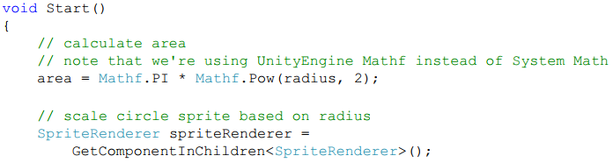
9.8 Putting It All Together: The Circle Problem in Unity Revisited
Write the Code
Use these two constants to offset the radius and area text from the center of the circle sprite.

Slide 13

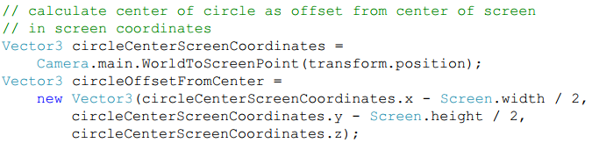
9.8 Putting It All Together: The Circle Problem in Unity Revisited
Write the Code
Circle game object, trying to find a SpriteRenderer component; when it finds it (in the circle sprite), it puts that component into the spriteRenderer variable. We need this reference to scale the circle sprite based on the Circle's radius.

Slide 14
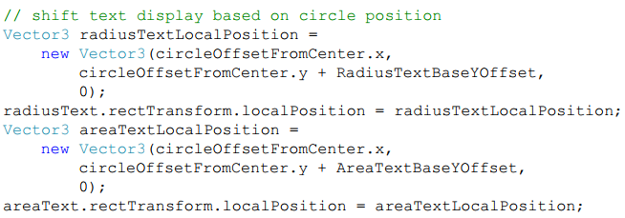
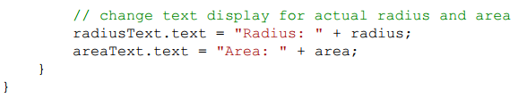
9.8 Putting It All Together: The Circle Problem in Unity Revisited
Write the Code

Slide 15
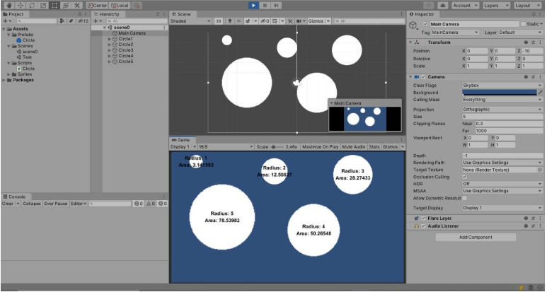
9.8 Putting It All Together: The Circle Problem in Unity Revisited
Test the Code
Test Case 1: Checking Radius and Area Info Results

Slide 16
Exercise 34: The Counting Bouncer
View LMS

Slide 17
Unity Audio

Slide 18
Content
Adding Audio Content
Audio Sources and the Audio Listener
Playing Audio Clips from Scripts
Exercise 35: The Loud Bouncer

Slide 19
9.9 Adding Audio Content
The first thing you need to do to add audio to your game is to actually create the audio assets. You can do that in a number of different ways, including using a microphone to record sounds or voices, converting music files into a usable format, and so on.
Adding the audio files to the Unity project is just as easy as adding sprites; all we need to do is copy the files into our project.

Slide 20
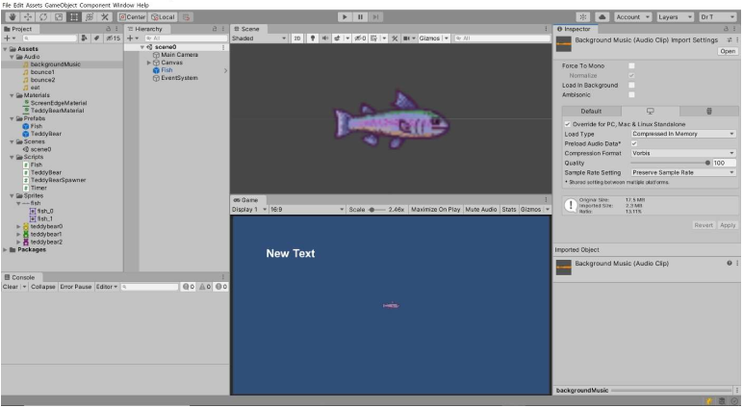
9.9 Adding Audio Content
Audio Clip Import

Slide 21
9.10 Audio Sources and the Audio Listener
The general idea behind audio in Unity is that there are one or more Audio Sources (e.g., things making noise) and one Audio Listener (e.g., the thing that hears the noise).
If you have a bunch of Audio Sources making tree falling in a forest sounds but no Audio Listener, you won't hear any of those sounds in your game.
By default, the Main Camera has an Audio Listener component attached to it.
If you're doing fancy stuff like having the direction a sound is coming from important to player immersion, you might decide to remove the Audio Listener from the Main Camera and attach an Audio Listener to a different object (most commonly, the player) instead. For our 2D game here, though, leaving the Audio Listener on the Main Camera will work fine.

Slide 22
9.10 Audio Sources and the Audio Listener
Add Audio Source components to the game objects that will play the audio in our game. We'll start with the background music; it makes sense for the Main Camera to just play the background music for the game.
Select the Main Camera in the Hierarchy window, click the Add Component button at the bottom of the Inspector, and select Audio > Audio Source.

Slide 23
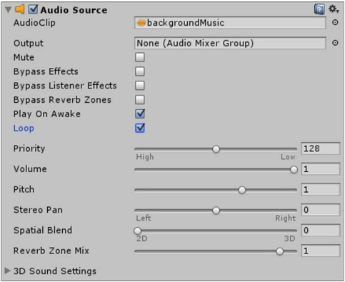
9.10 Audio Sources and the Audio Listener
Main Camera Audio Source Component

Slide 24
9.11 Playing Audio Clips from Scripts
Since we detect when the fish eats a teddy bear in the Fish OnCollisionEnter2D method, we'll add the Audio Source for this sound effect to the Fish prefab.
Select the Fish prefab in the prefabs folder in the Project window, click the Add Component button at the bottom of the Inspector, and select Audio > Audio Source.
Drag eat from the Audio folder in the Project window and drop it on the AudioClip field of the Audio Source component in the Inspector.
Uncheck the check box for the Play On Awake field; we don't want the sound effect to play when we add the Fish to the scene (which is what Play On Awake does), we want to play the sound effect from the Fish script when the fish eats a teddy bear.

Slide 25
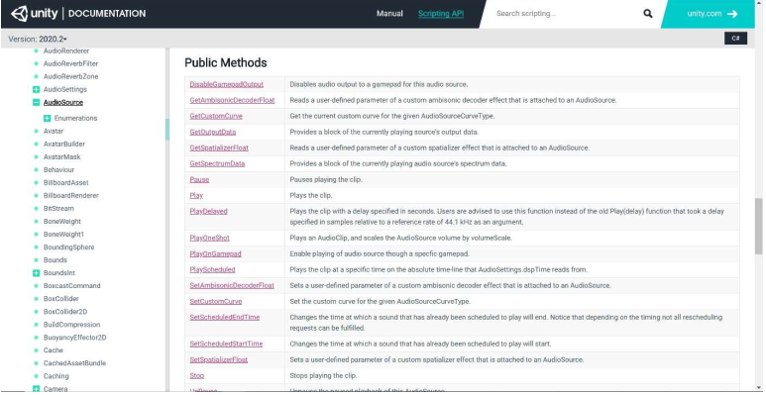
9.11 Playing Audio Clips from Scripts
AudioSource Documentation

Slide 26

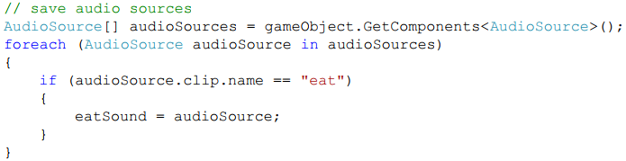
9.11 Playing Audio Clips from Scripts
Add a field to the Fish script
Populate that field in the Fish Start method using the following code:

Slide 27

9.11 Playing Audio Clips from Scripts
Play the eat sound when the fish eats a teddy bear (in the Fish OnCollisionEnter2D method).
Add two more Audio Source components to the Fish prefab, one for bounce1 and one for bounce2.
add one more field to the Fish script

Slide 28
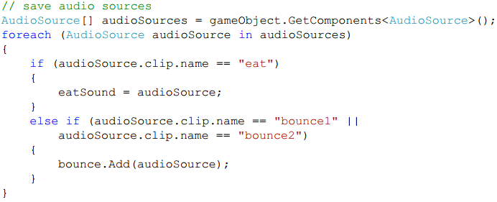
9.11 Playing Audio Clips from Scripts
Add code to the Fish Start method to add the Audio Sources for the bounce1 and bounce2 clips to our new bounce field.

Slide 29

9.11 Playing Audio Clips from Scripts
Change the Fish OnCollisionEnter2D method to play one of the bounce sound effects when we've detected a collision between the fish and a teddy bear that's not at the front of the fish.

Slide 30
Exercise 35: The Loud Bouncer
View LMS

Slide 31
Summary
String
Text Output
Text Input
Audio

